Slide 1
UI elements in Android

Slide 2
Lecture Agenda
Overview of Layouts
Overview of Elements
Debugging tools
Play with all that ☺

Slide 3
Common Layouts

Slide 4
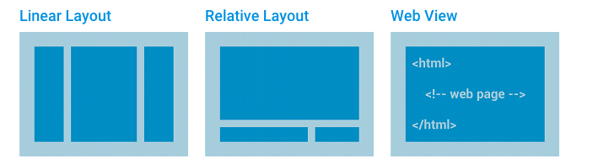

Slide 5
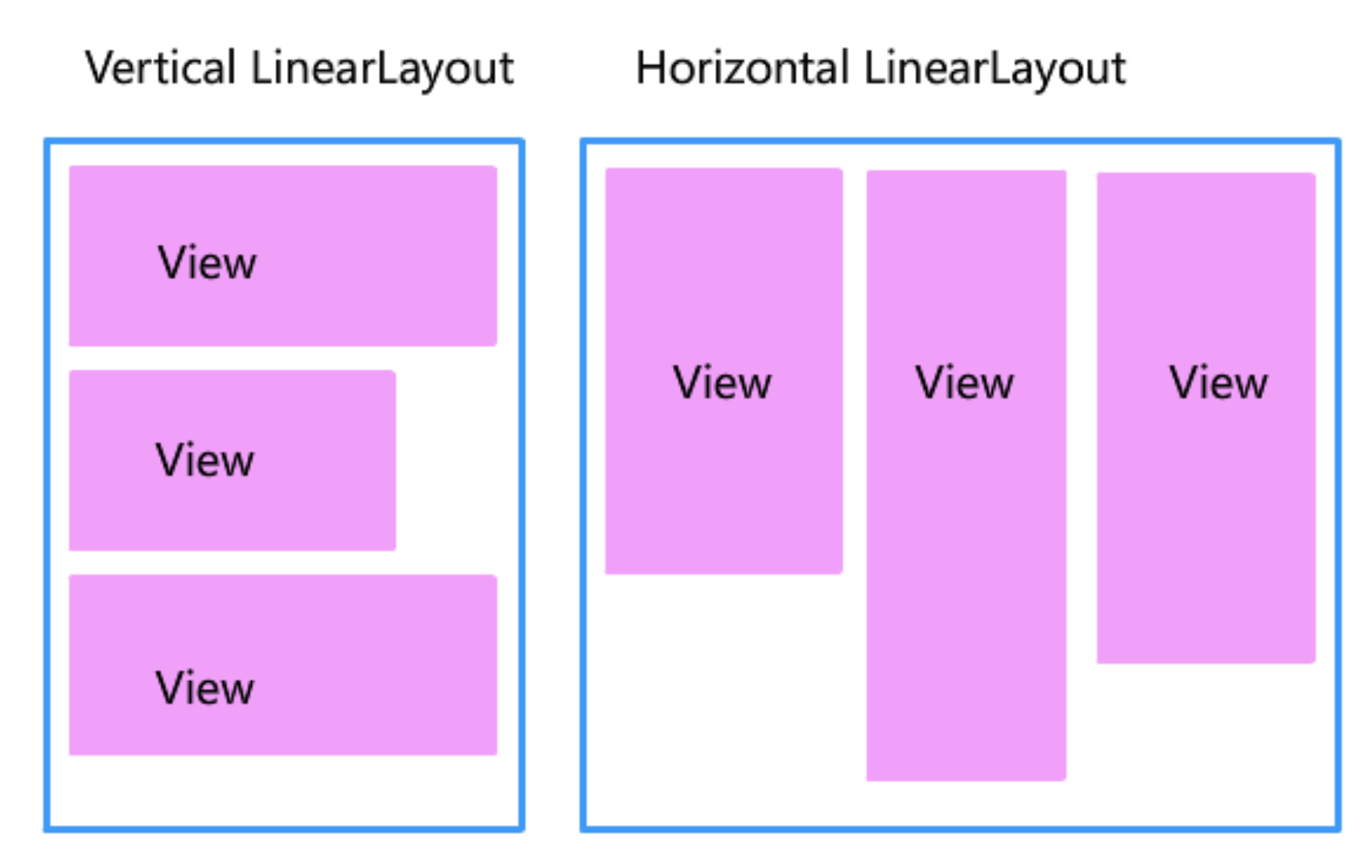

Slide 6
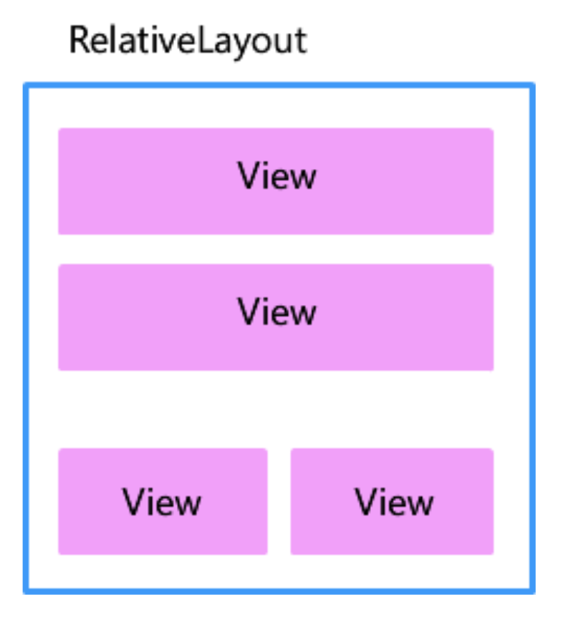

Slide 7
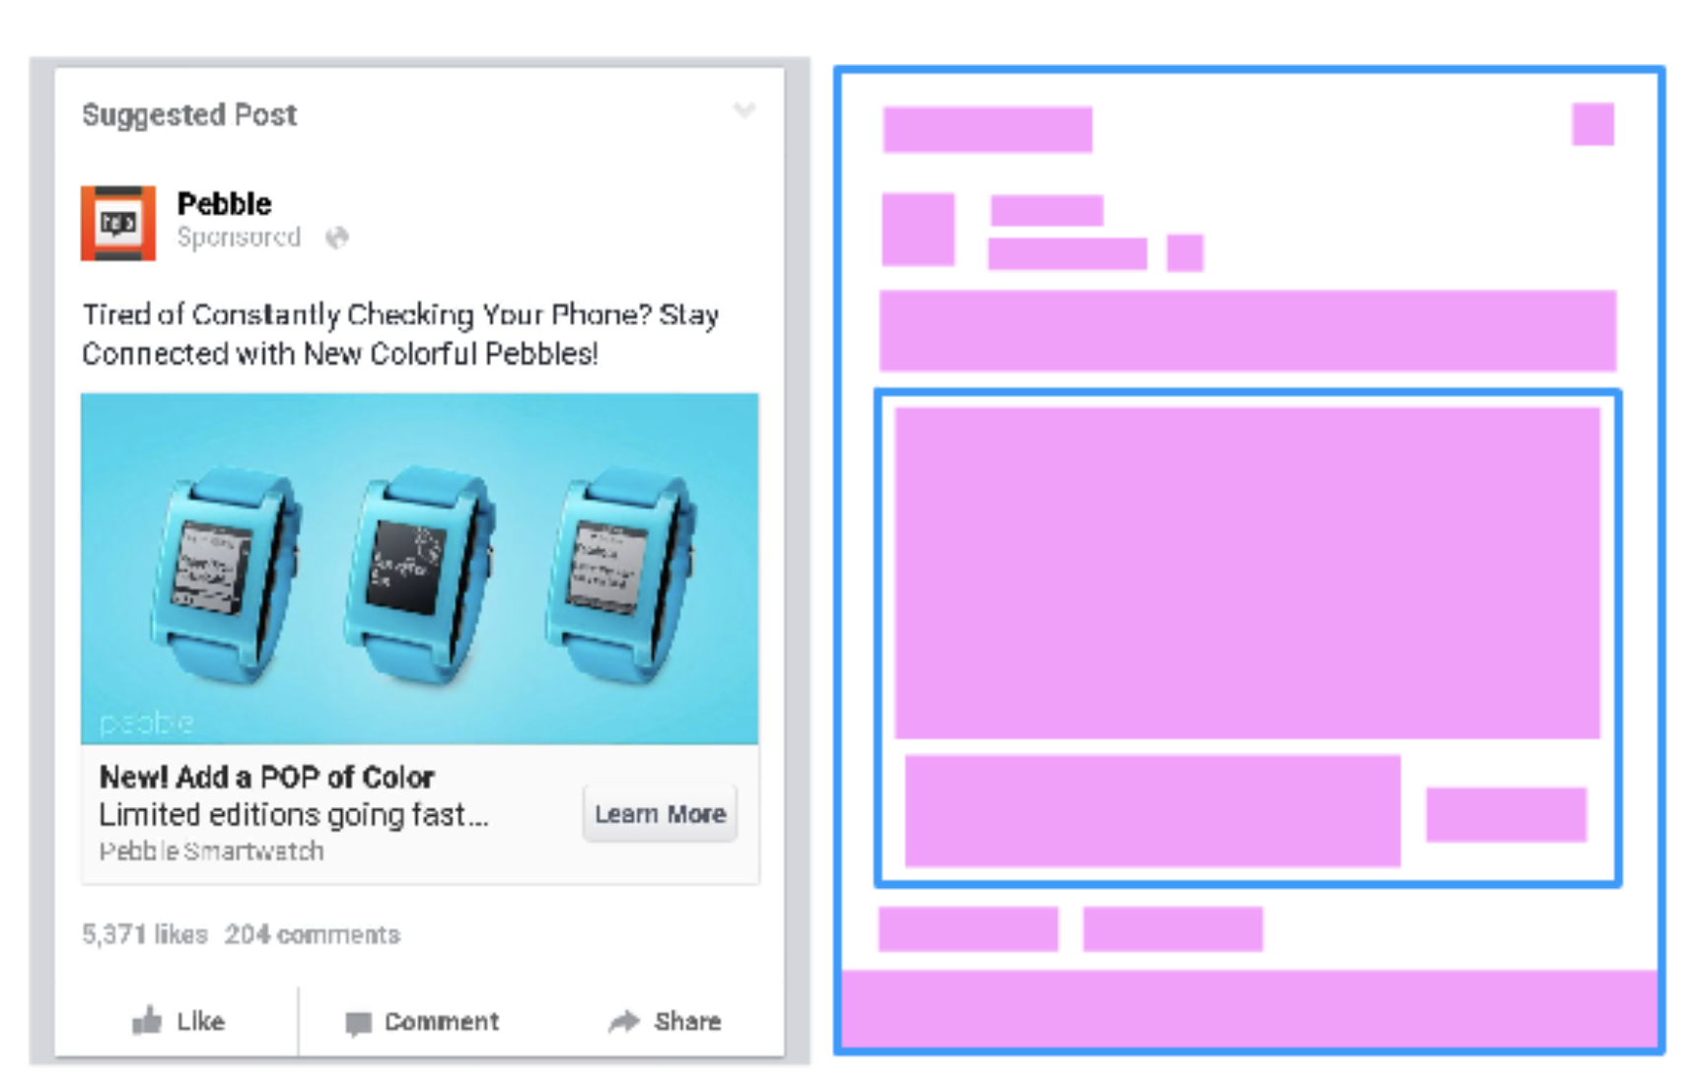

Slide 8
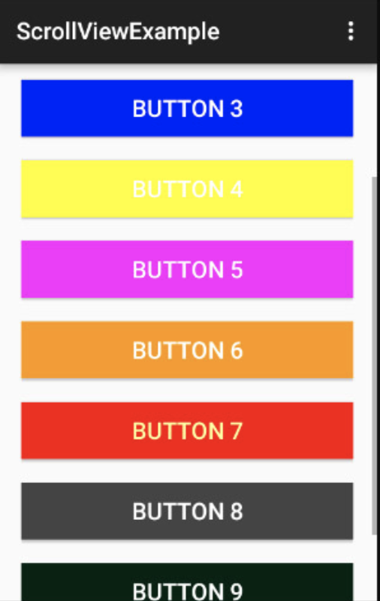
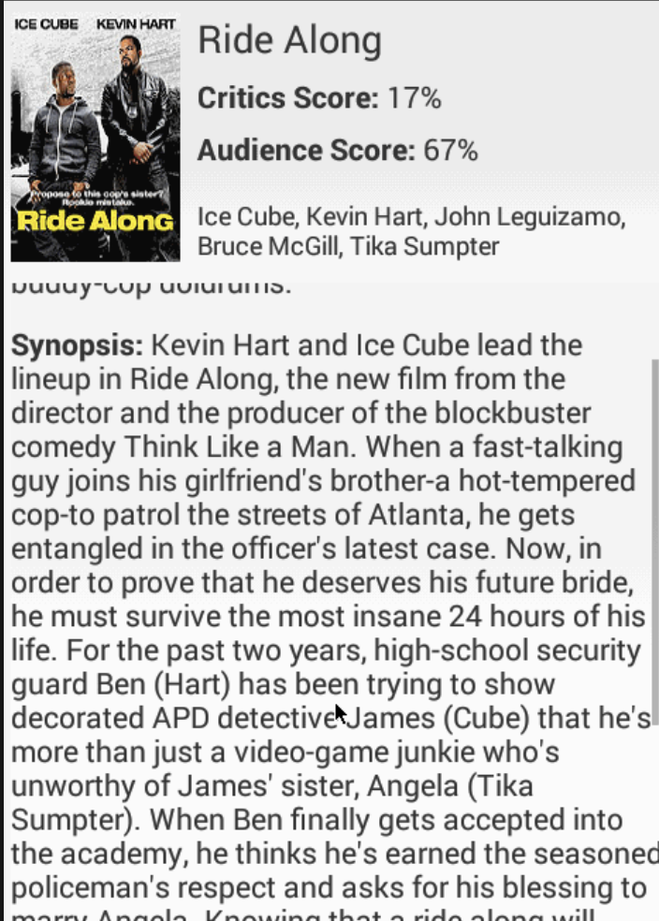
Scroll view
Allows to scroll content, if it does not fit on screen
Allows scroll X and Y

Slide 9
ScrollView
When an app has layout content that might be longer than the height of the device and that content should be vertically scrollable, then we need to use a ScrollView.
Note that a ScrollView can only contain a single child element so if you need multiple things to be scrollable, you need to wrap that content into a layout as shown above.
https://guides.codepath.com/android/Working-with-the-ScrollView

Slide 10
Linear Layout
A layout that organizes its children into a single horizontal or vertical row
Relative Layout
Enables you to specify the location of child objects relative to each other (child A to the left of child B) or to the parent (aligned to the top of the parent).
WebView
Displays web pages.
Note: Although you can nest one or more layouts within another layout to achieve your UI design, you should strive to keep your layout hierarchy as shallow as possible. Your layout draws faster if it has fewer nested layouts (a wide view hierarchy is better than a deep view hierarchy).

Slide 11
tutorialspoint
https://www.tutorialspoint.com/android/android_user_interface_layouts.htm

Slide 12
relative measurements

Slide 13
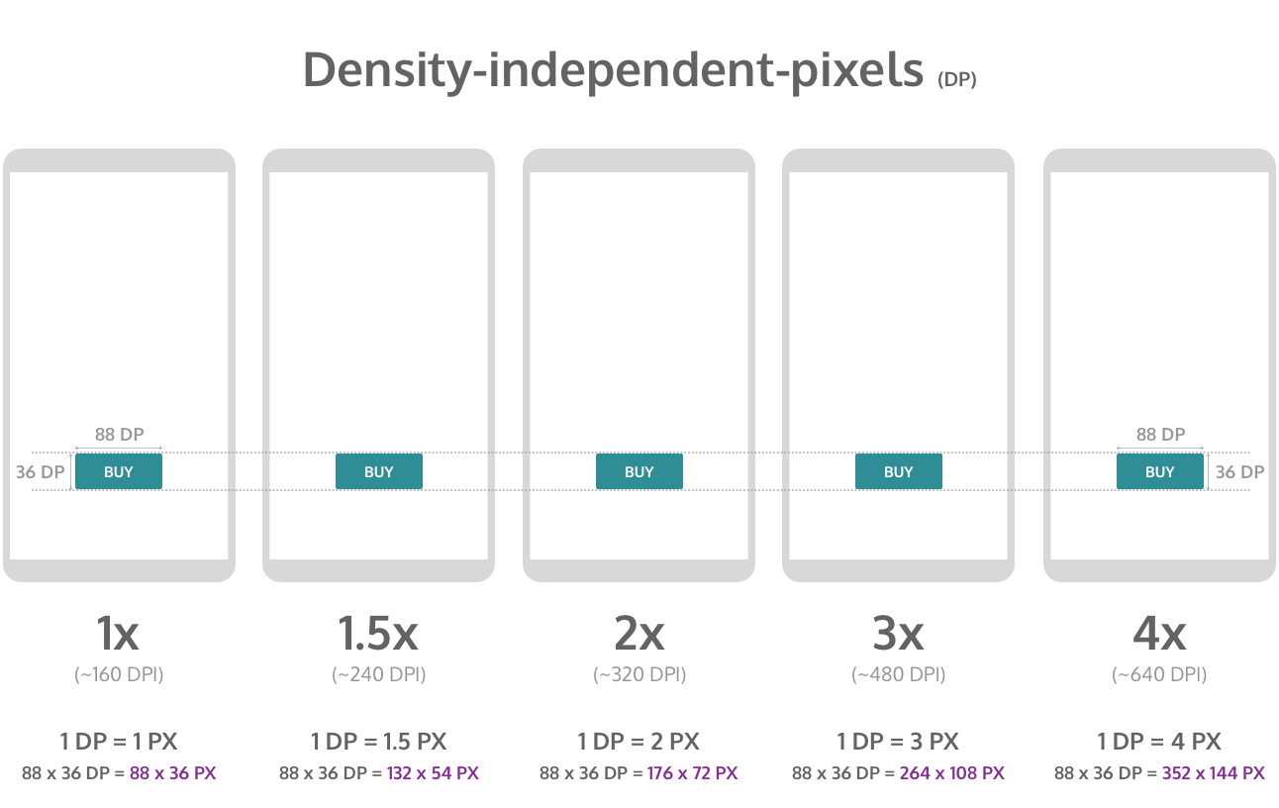

Slide 14
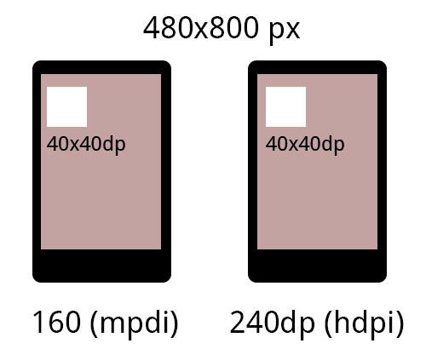

Slide 15
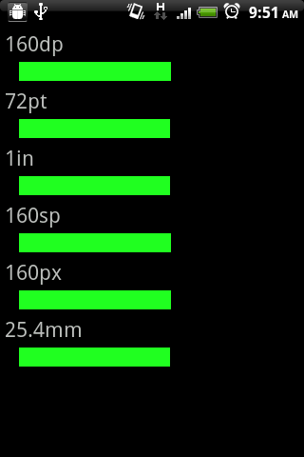

Slide 16
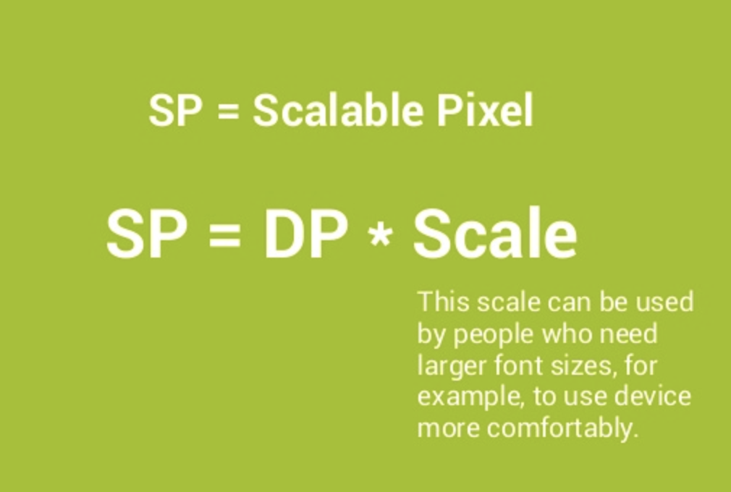

Slide 17
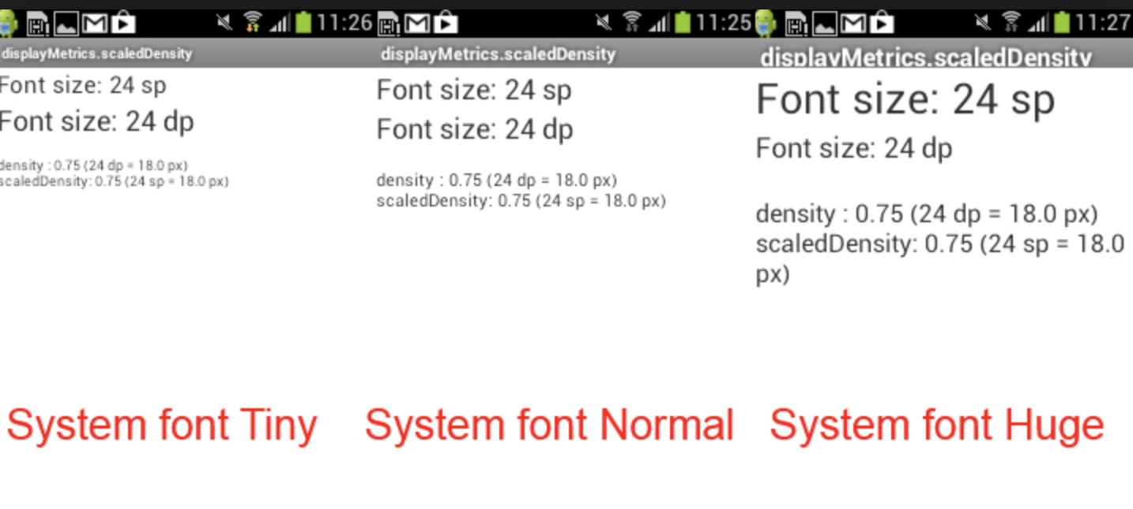

Slide 18
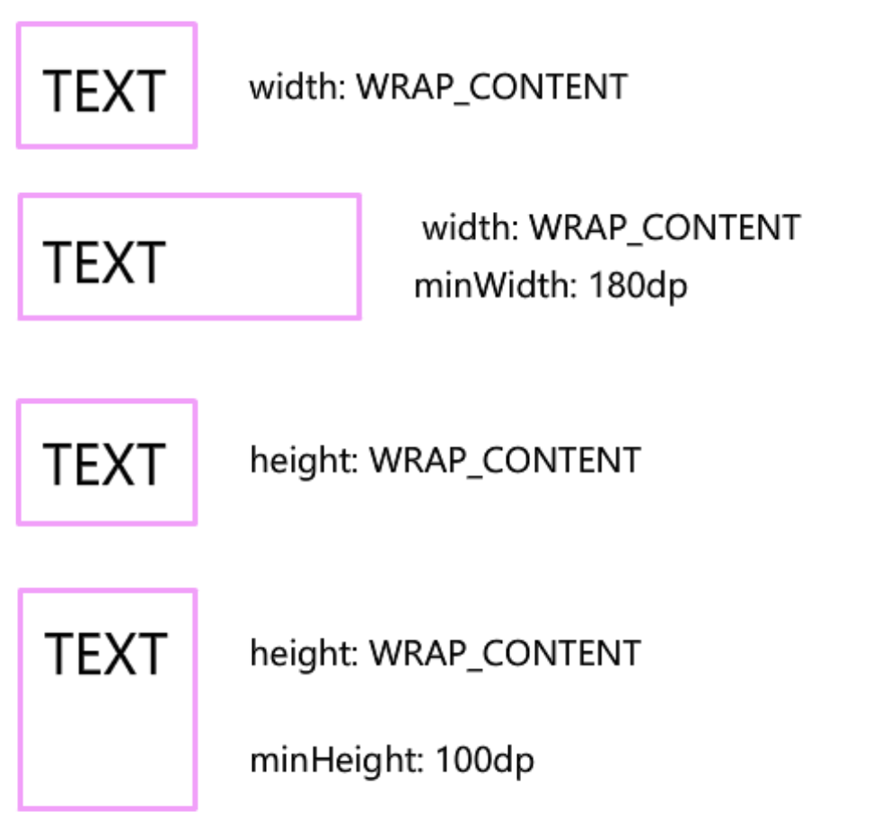

Slide 19
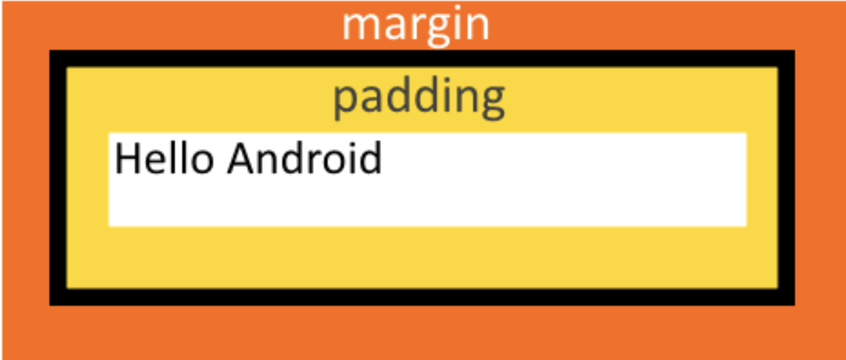

Slide 20
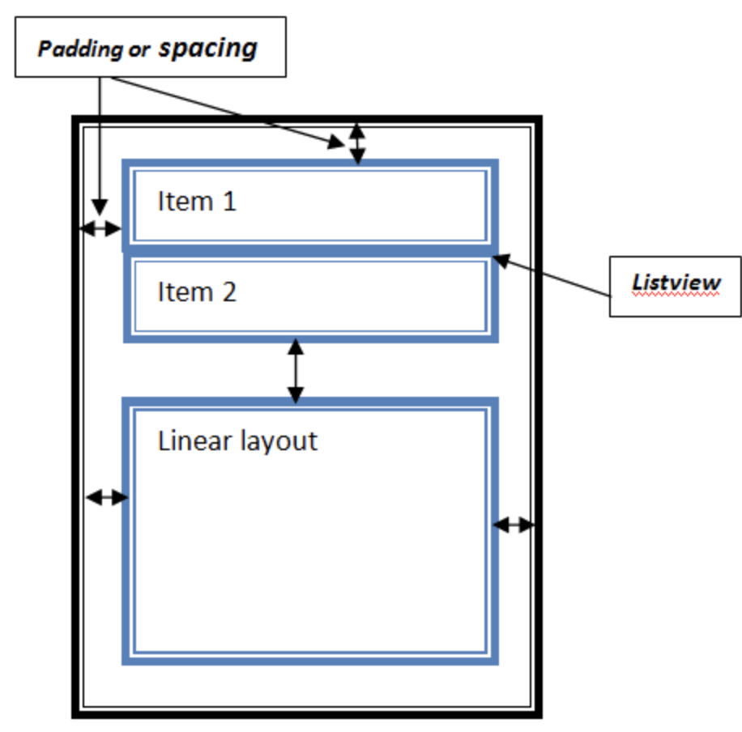

Slide 21
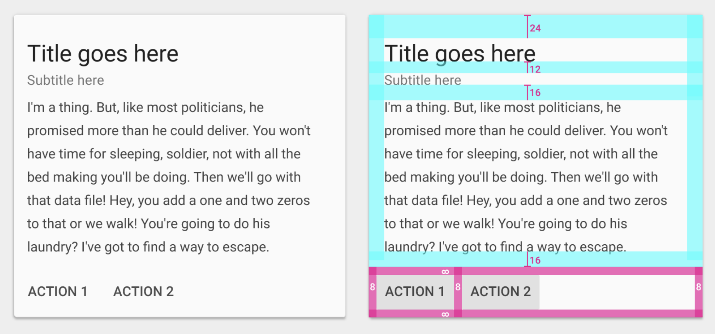

Slide 22
density-independent pixel units (dp)
scale-independent pixels (sp)
wrap_content tells your view to size itself to the dimensions required by its content.
match_parent tells your view to become as big as its parent view group will allow.

Slide 23
density-independent pixel units (dp)
dp or dip
Density-independent Pixels - an abstract unit that is based on the physical density of the screen. These units are relative to a 160 dpi screen, so one dp is one pixel on a 160 dpi screen. The ratio of dp-to-pixel will change with the screen density, but not necessarily in direct proportion. Note: The compiler accepts both "dip" and "dp", though "dp" is more consistent with "sp".

Slide 24
Scale-independent Pixels (SP)
Scale-independent Pixels - this is like the dp unit, but it is also scaled by the user's font size preference. It is recommended you use this unit when specifying font sizes, so they will be adjusted for both the screen density and user's preference.

Slide 25
Elements

Slide 26
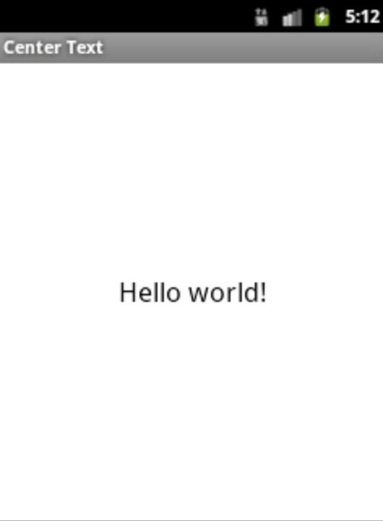
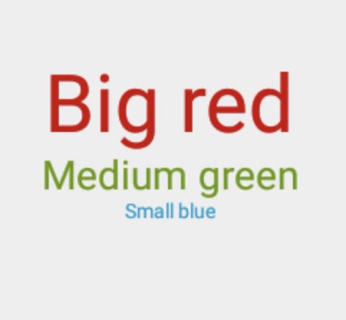
Text View

Slide 27
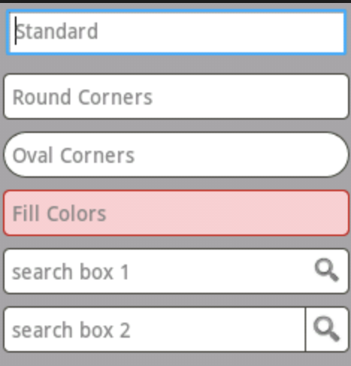
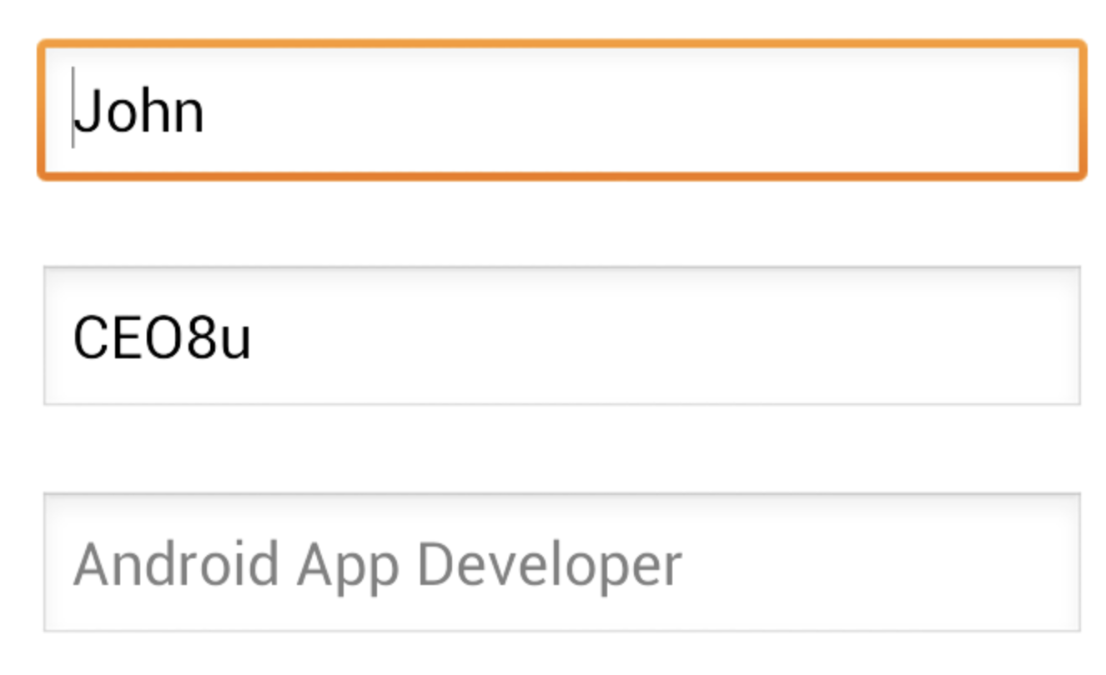
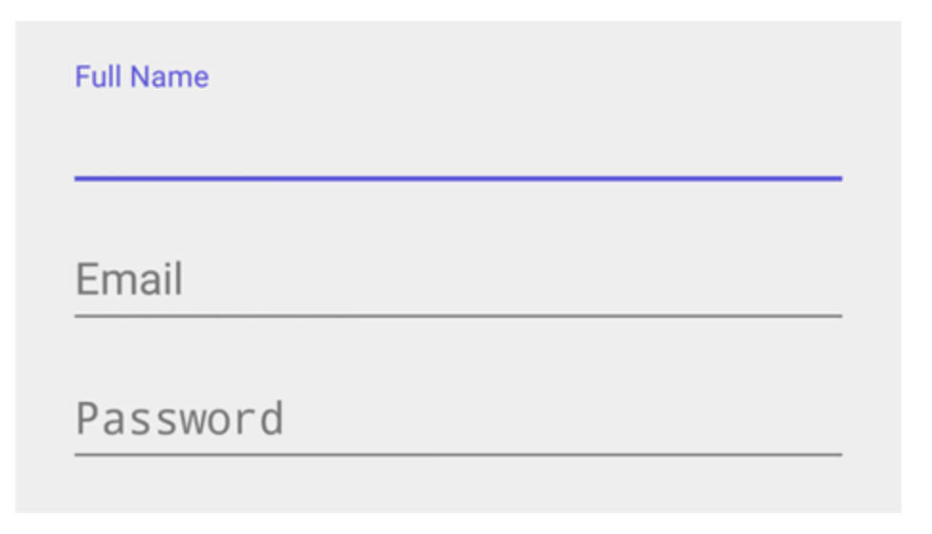
Edit text

Slide 28
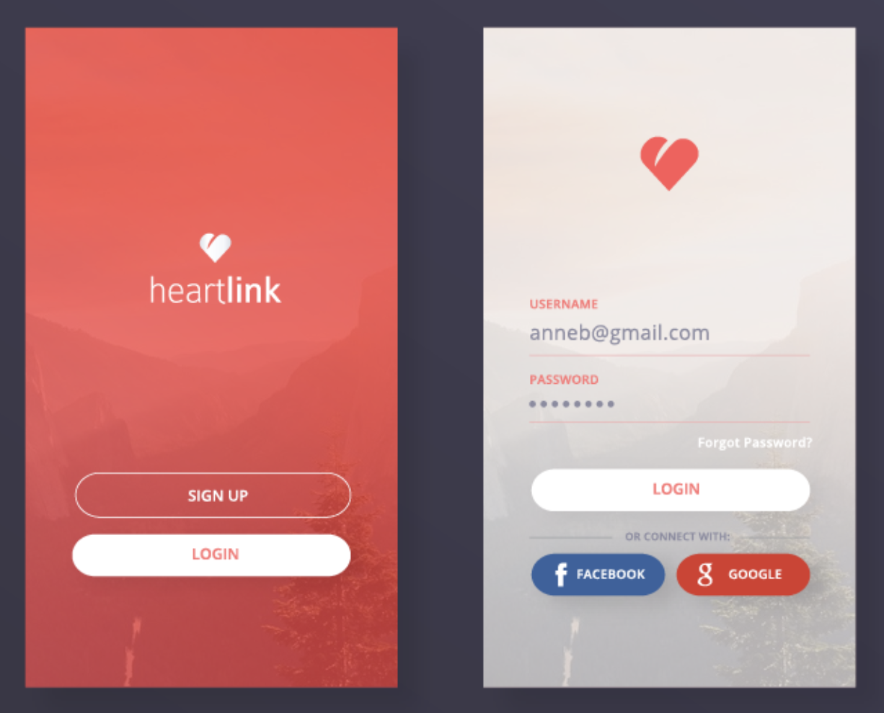
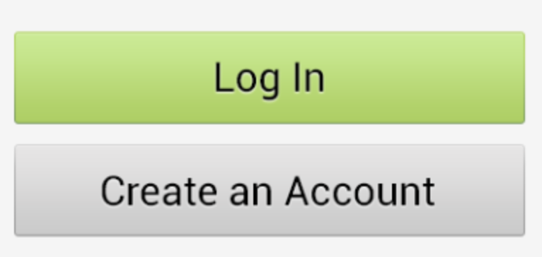
Button

Slide 29
ImageButton
Can’t set text
Can set image scale

Slide 30
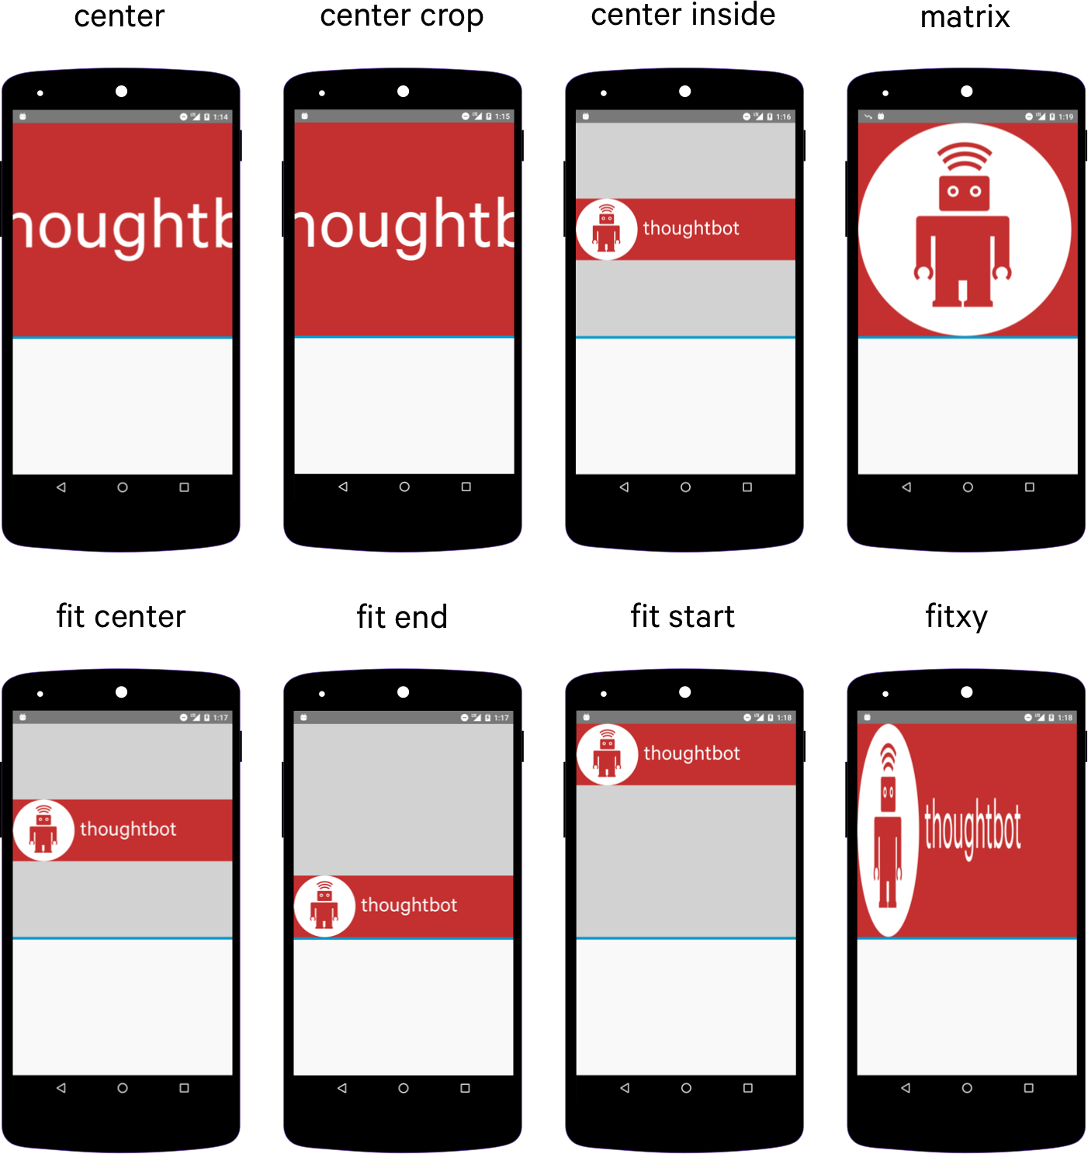
scale type

Slide 31
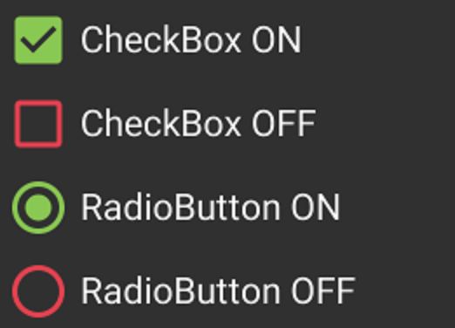
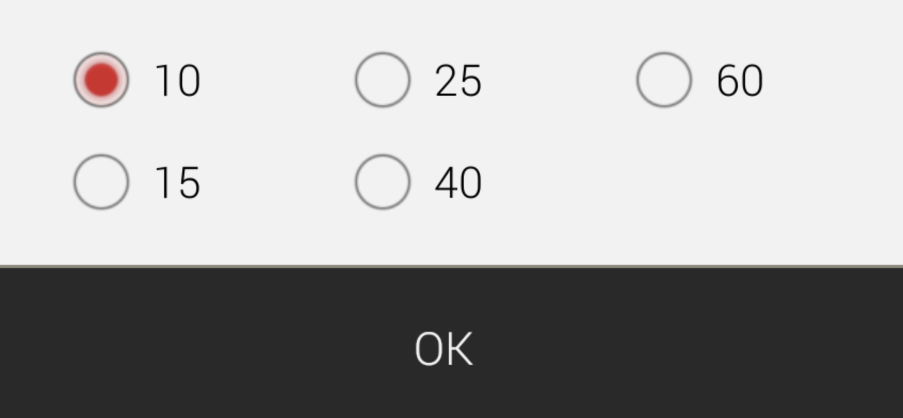
Check box and Radio buttons

Slide 32
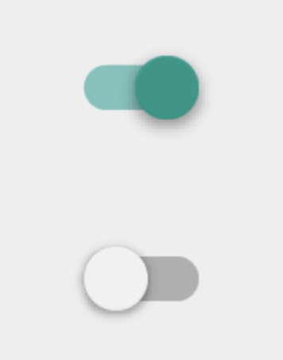
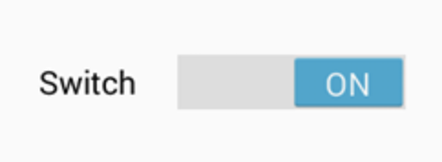
Toggle button (Switches)

Slide 33
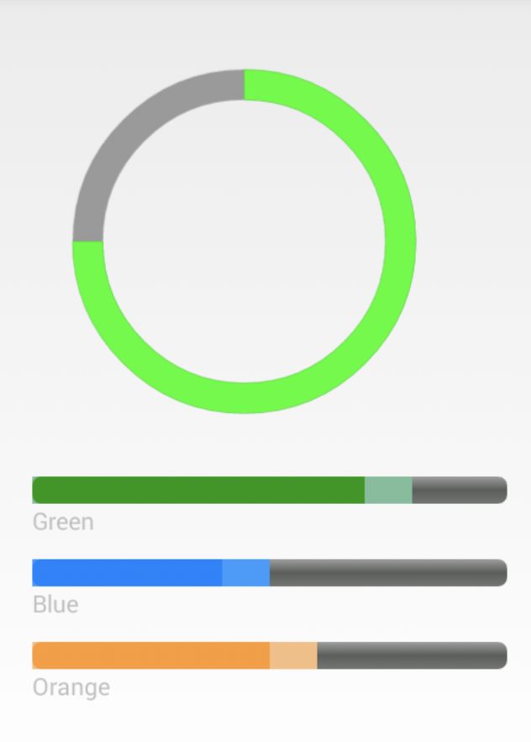
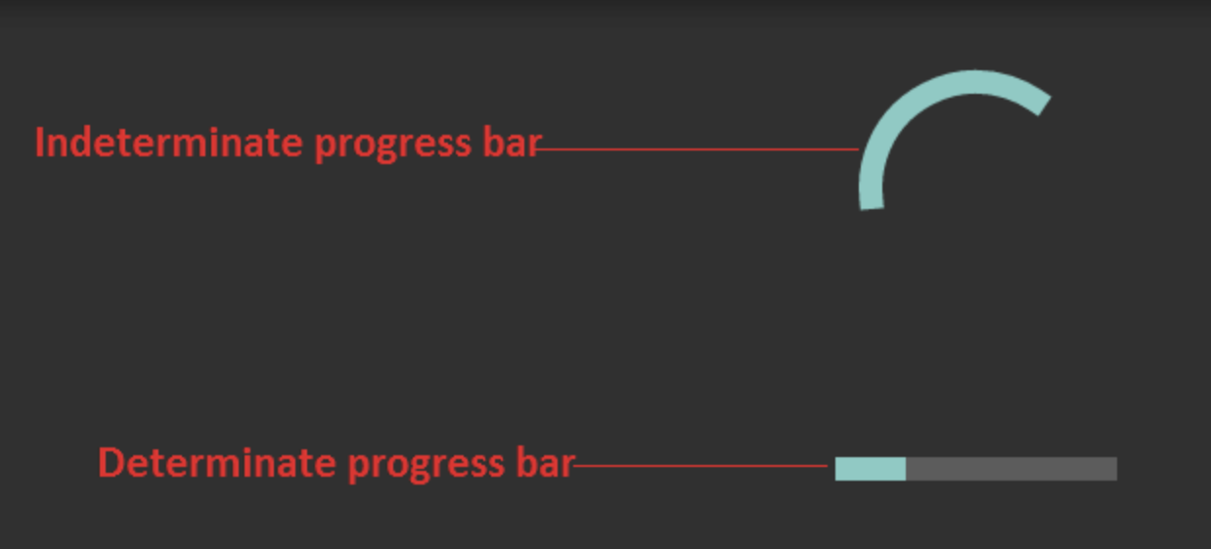
Progress bar

Slide 34
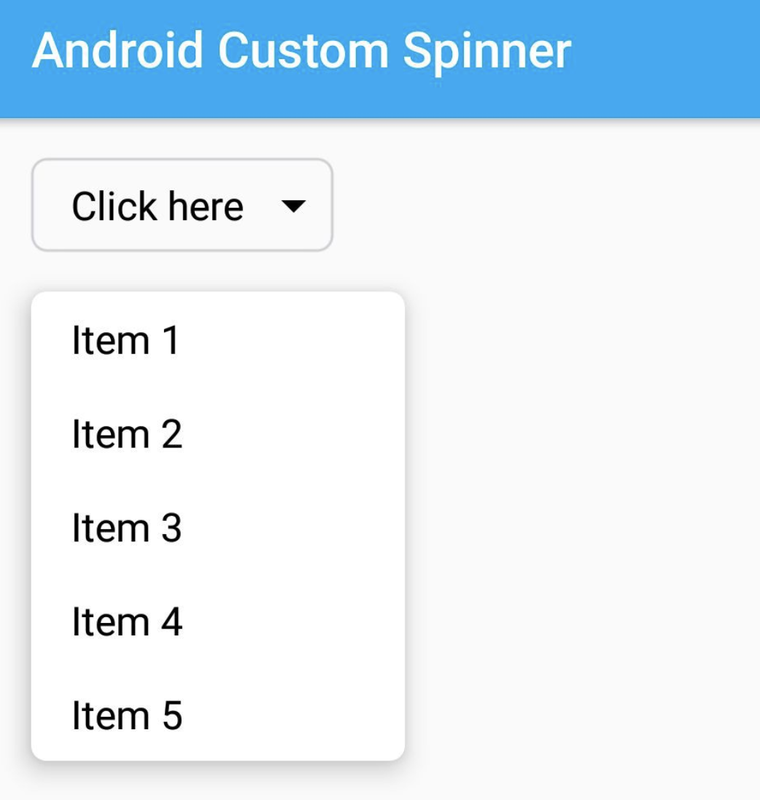
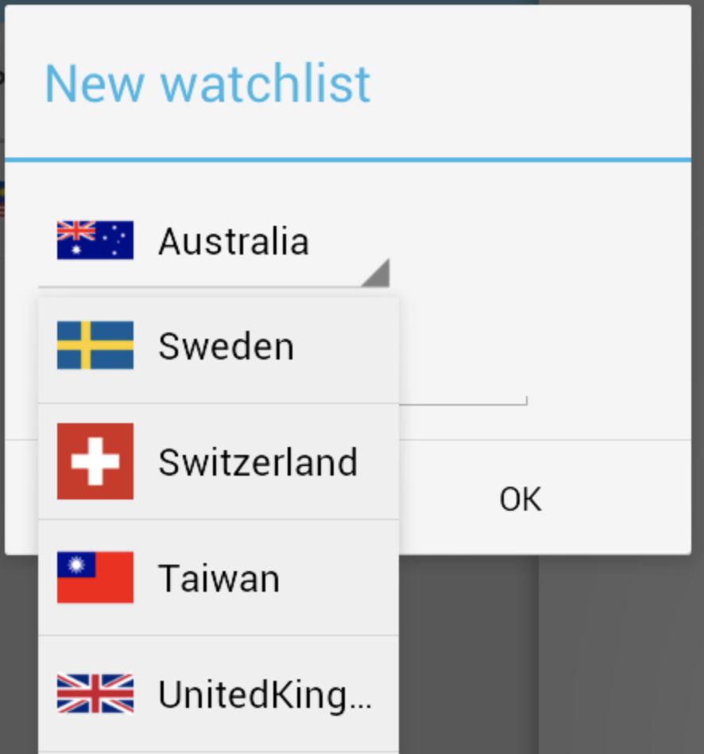
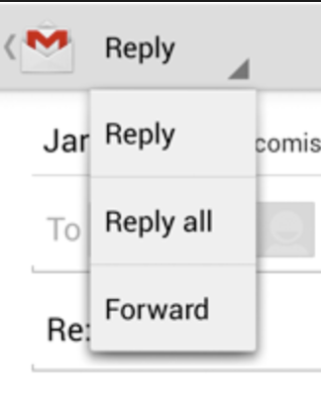
Spinner

Slide 35
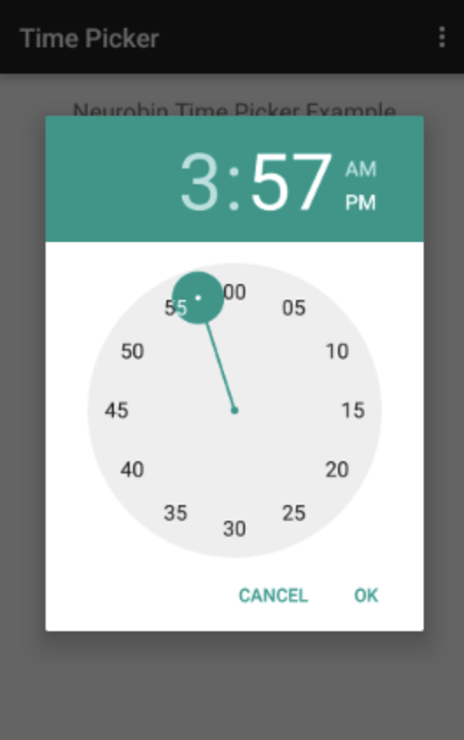
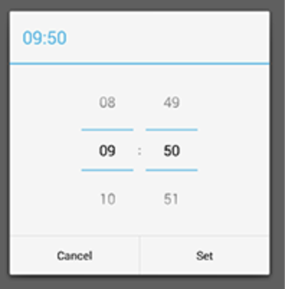
Time Picker

Slide 36
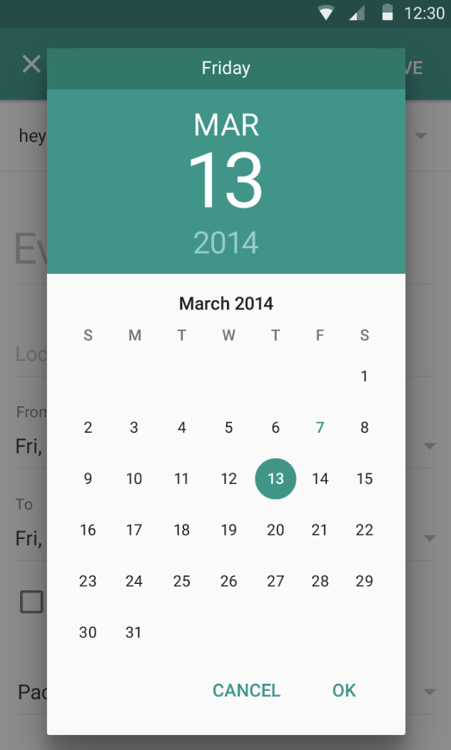
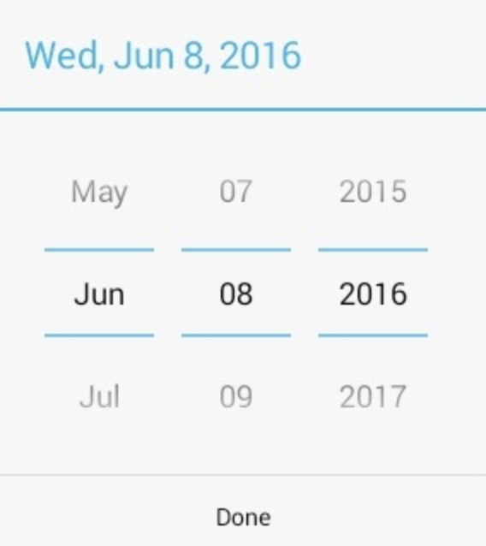
Date picker

Slide 37
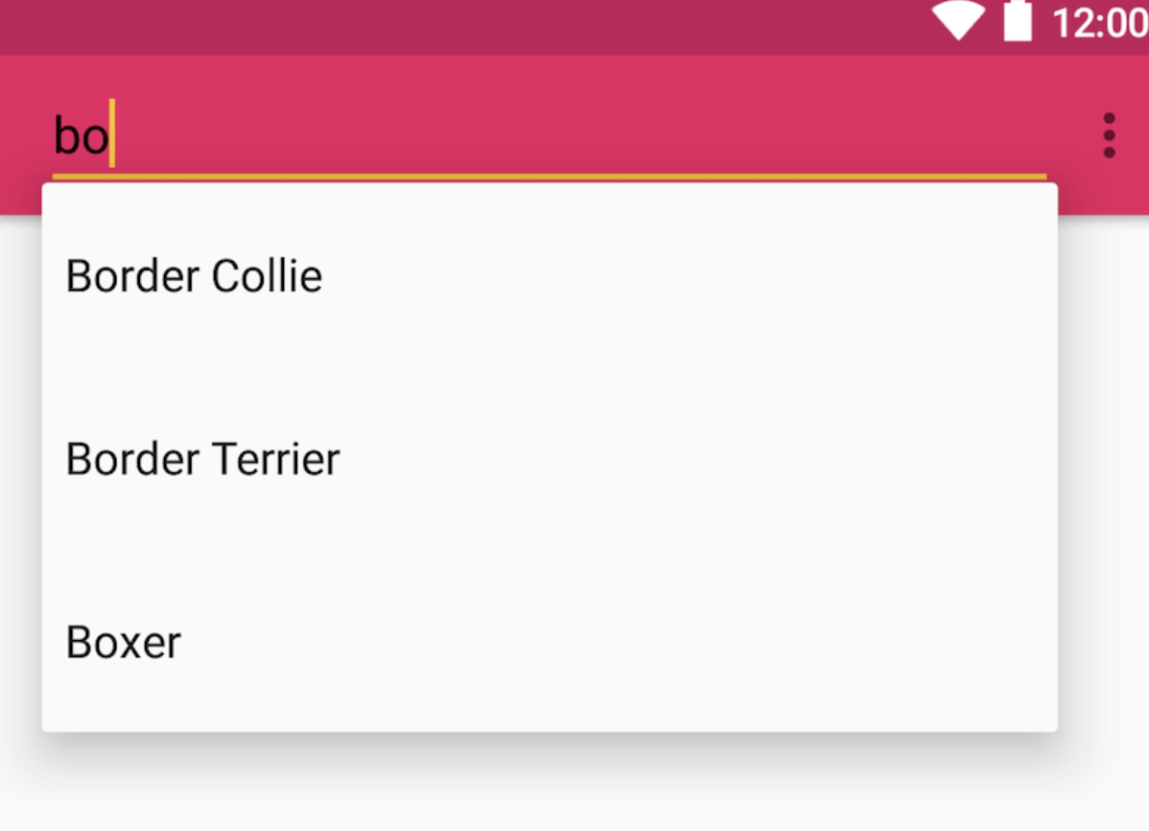
AutoCompleteTextView

Slide 38
UI Control & Description
TextView
This control is used to display text to the user.
EditText
EditText is a predefined subclass of TextView that includes rich editing capabilities.
Button
A push-button that can be pressed, or clicked, by the user to perform an action.
ImageButton
An ImageButton is an AbsoluteLayout which enables you to specify the exact location of its children. This shows a button with an image (instead of text) that can be pressed or clicked by the user.

Slide 39
UI Control & Description
CheckBox
An on/off switch that can be toggled by the user. You should use check box when presenting users with a group of selectable options that are not mutually exclusive.
ToggleButton
An on/off button with a light indicator.
RadioButton
The RadioButton has two states: either checked or unchecked.
RadioGroup
A RadioGroup is used to group together one or more RadioButtons.

Slide 40
UI Control & Description
ProgressBar
The ProgressBar view provides visual feedback about some ongoing tasks, such as when you are performing a task in the background.
Spinner
A drop-down list that allows users to select one value from a set.
TimePicker
The TimePicker view enables users to select a time of the day, in either 24-hour mode or AM/PM mode.
DatePicker
The DatePicker view enables users to select a date of the day.
AutoCompleteTextView
The AutoCompleteTextView is a view that is similar to EditText, except that it shows a list of completion suggestions automatically while the user is typing.

Slide 41
tutorialspoint
https://www.tutorialspoint.com/android/android_user_interface_controls.htm

Slide 42
Re-using Layouts with <include/>
Reusing layouts is particularly powerful as it allows you create reusable complex layouts. For example, a yes/no button panel, or custom progress bar with description text. It also means that any elements of your application that are common across multiple layouts can be extracted, managed separately, then included in each layout. So while you can create individual UI components by writing a custom View, you can do it even more easily by re-using a layout file.
https://developer.android.com/training/improving-layouts/reusing-layouts.html#Include

Slide 43
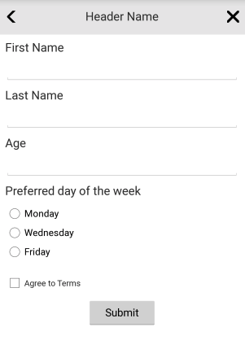
Include tag
Allows to re-use layouts components in multiple layouts
Use-full when you have a common elements across your app

Slide 44
Debugging Instruments

Slide 45
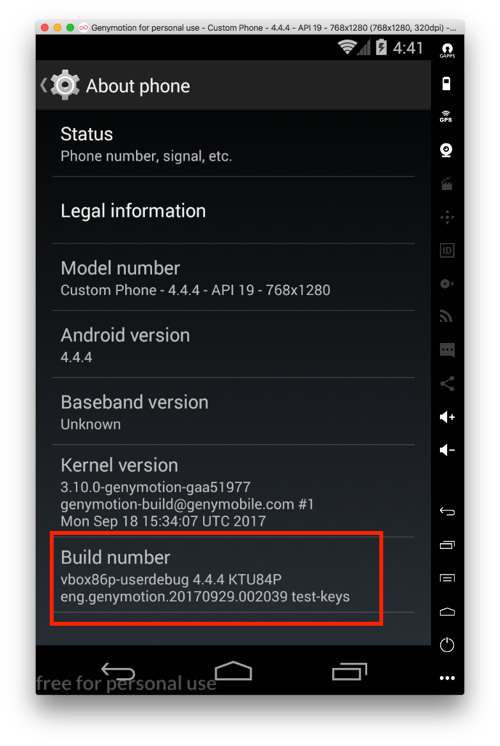
Activate Development mode
Press 5 times in a row on Build number

Slide 46
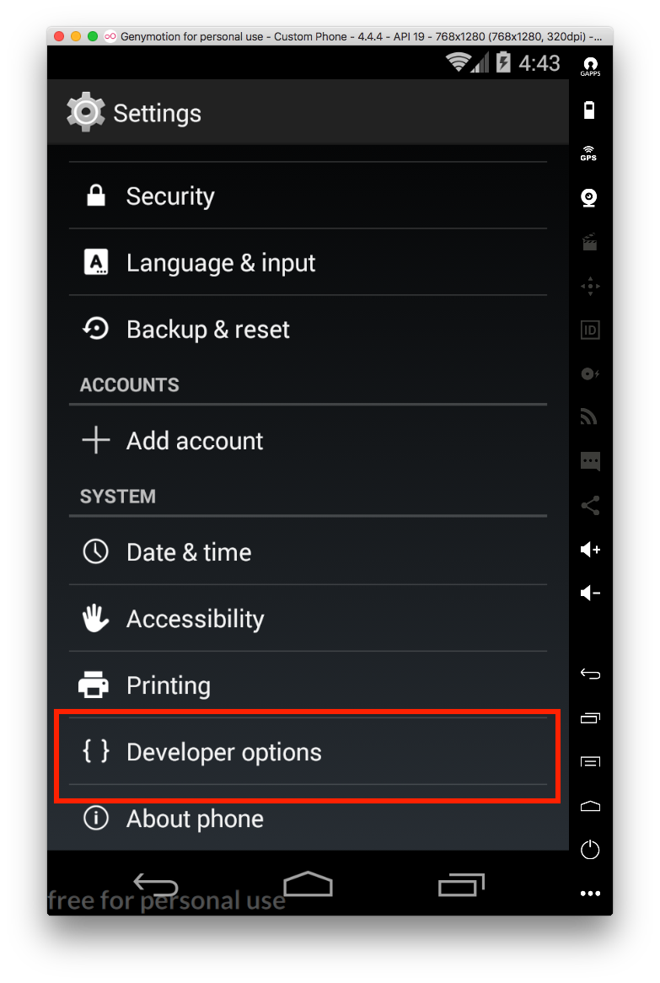

Slide 47
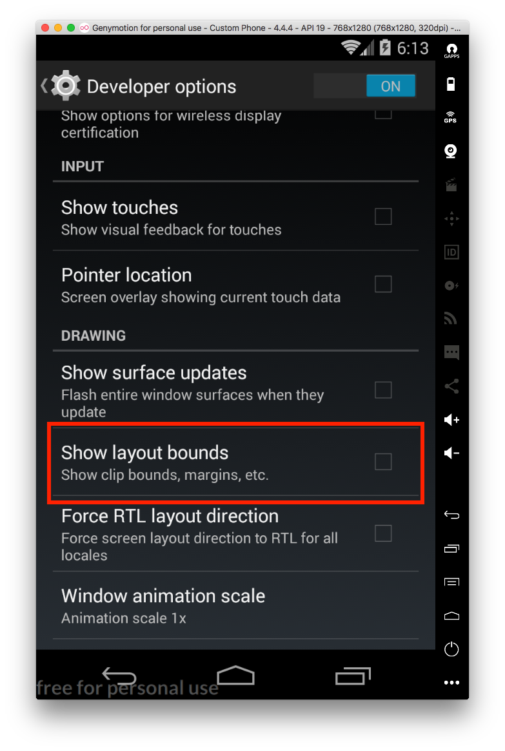
Show layout bounds in ANY app!

Slide 48
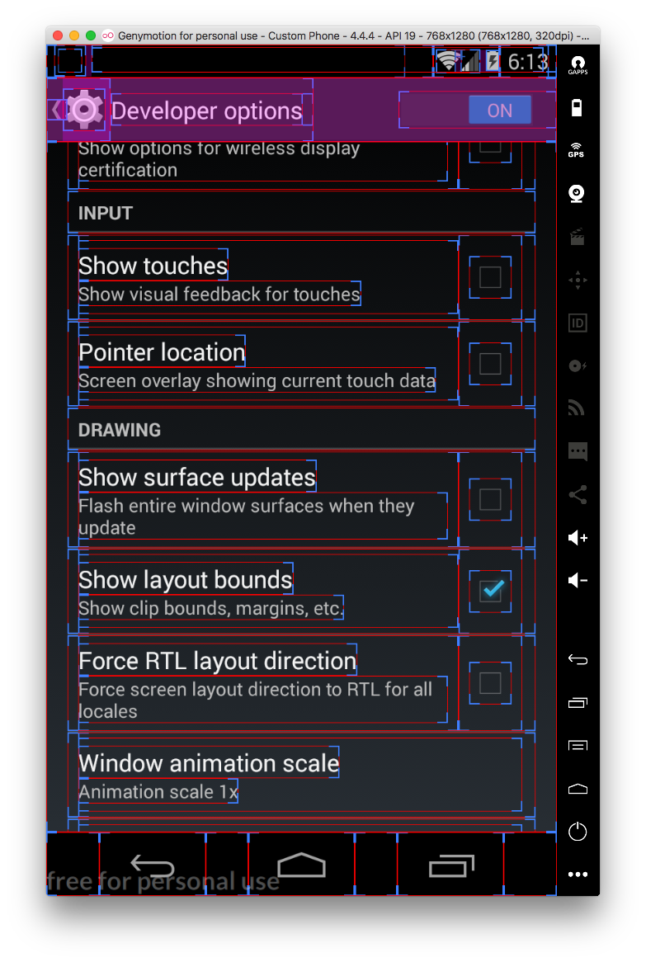
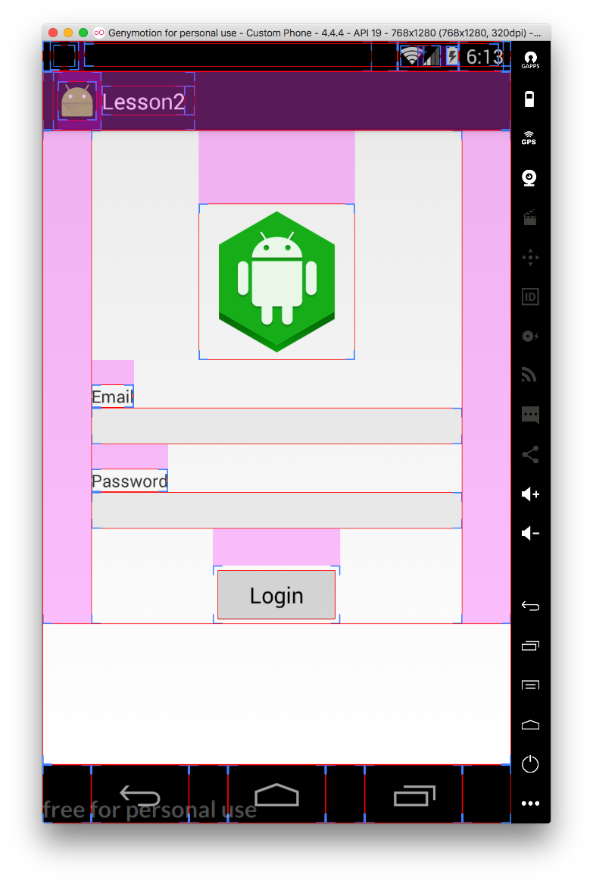

Slide 49
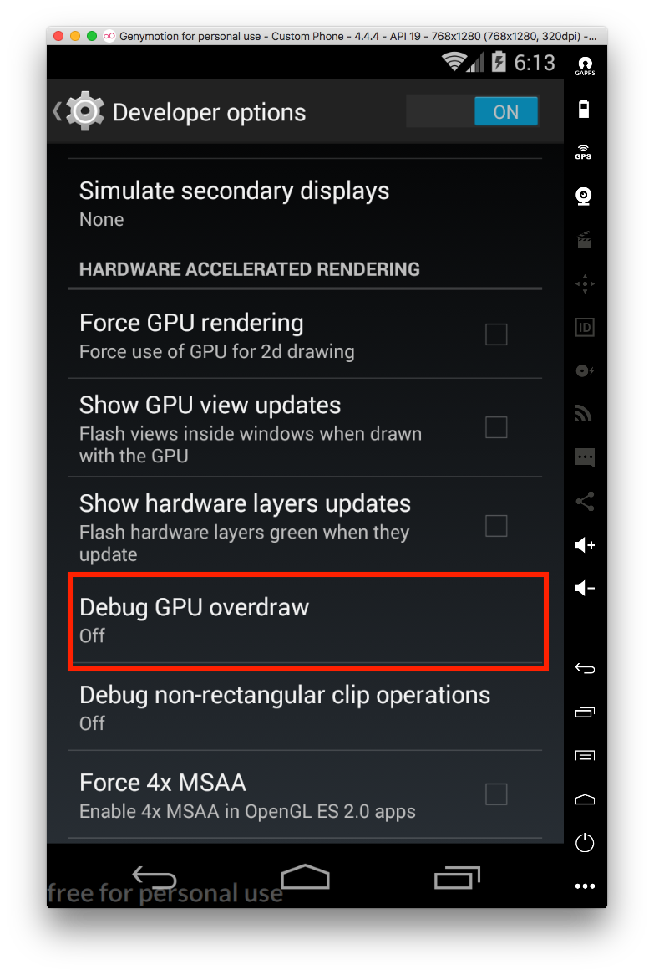
Draw cycles

Slide 50
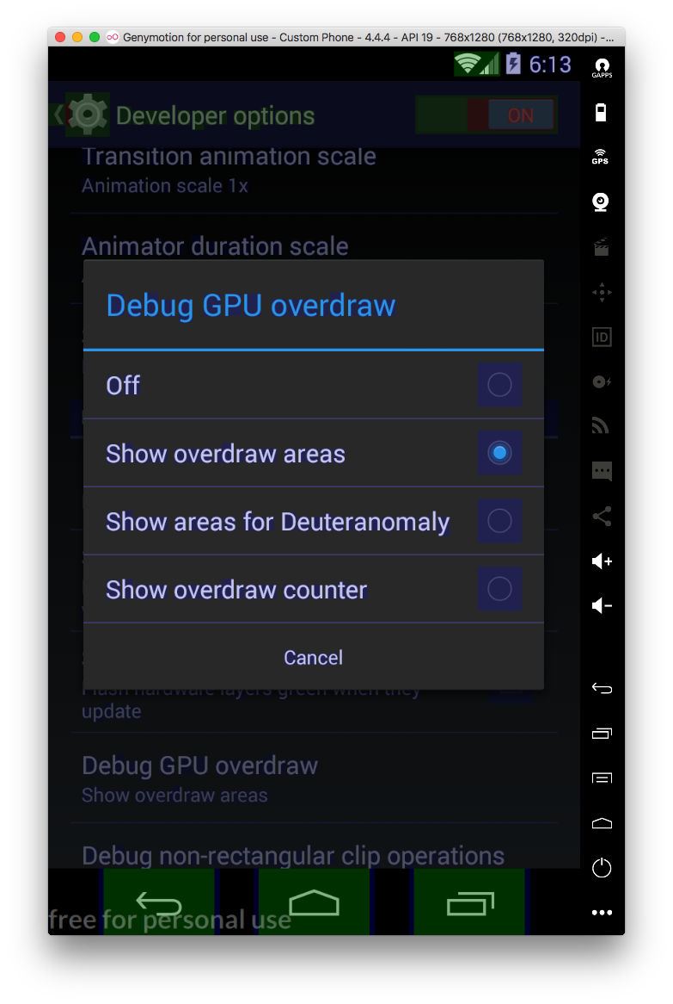

Slide 51
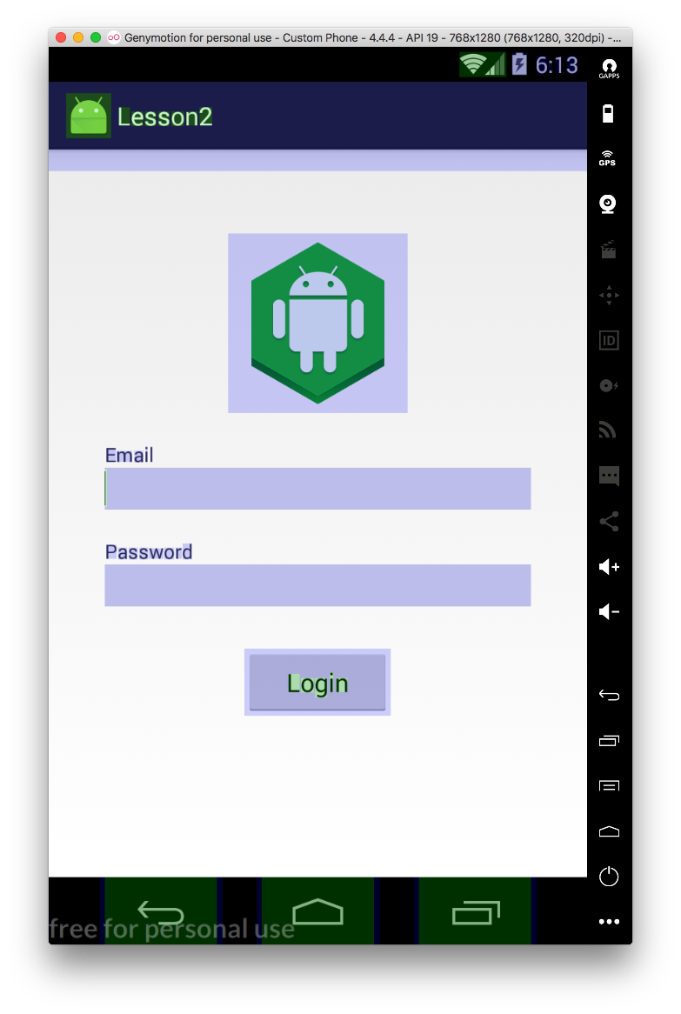
GOOD

Slide 52
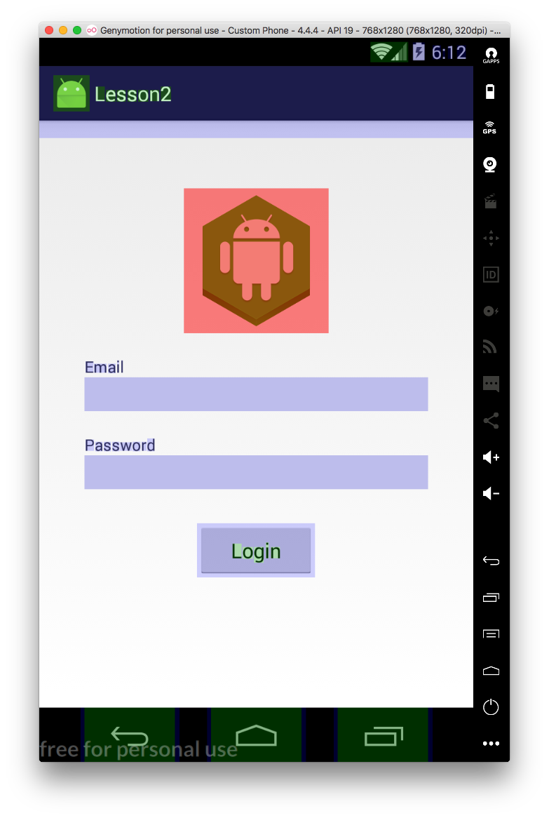
BAD

Slide 53
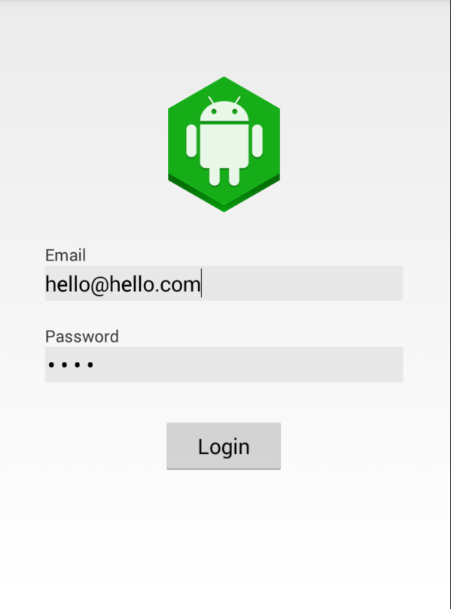
TODO: 1Construct a screen like that, requirements:
Password field should be secure input
All should look good on a small screen (240x320)
All strings from a resource file
All colors from a resource file
Logo optimized for a different screens (mdpi, xdpi, etc)

Slide 54

Home work Part 1

Slide 55
Home work Part 2
Requirements:
Header via<include> tag
All string in string file
Scrollable on a small screen

